Slide 1
Comparison of Summarization Dataset
Bumjin Park

Slide 2

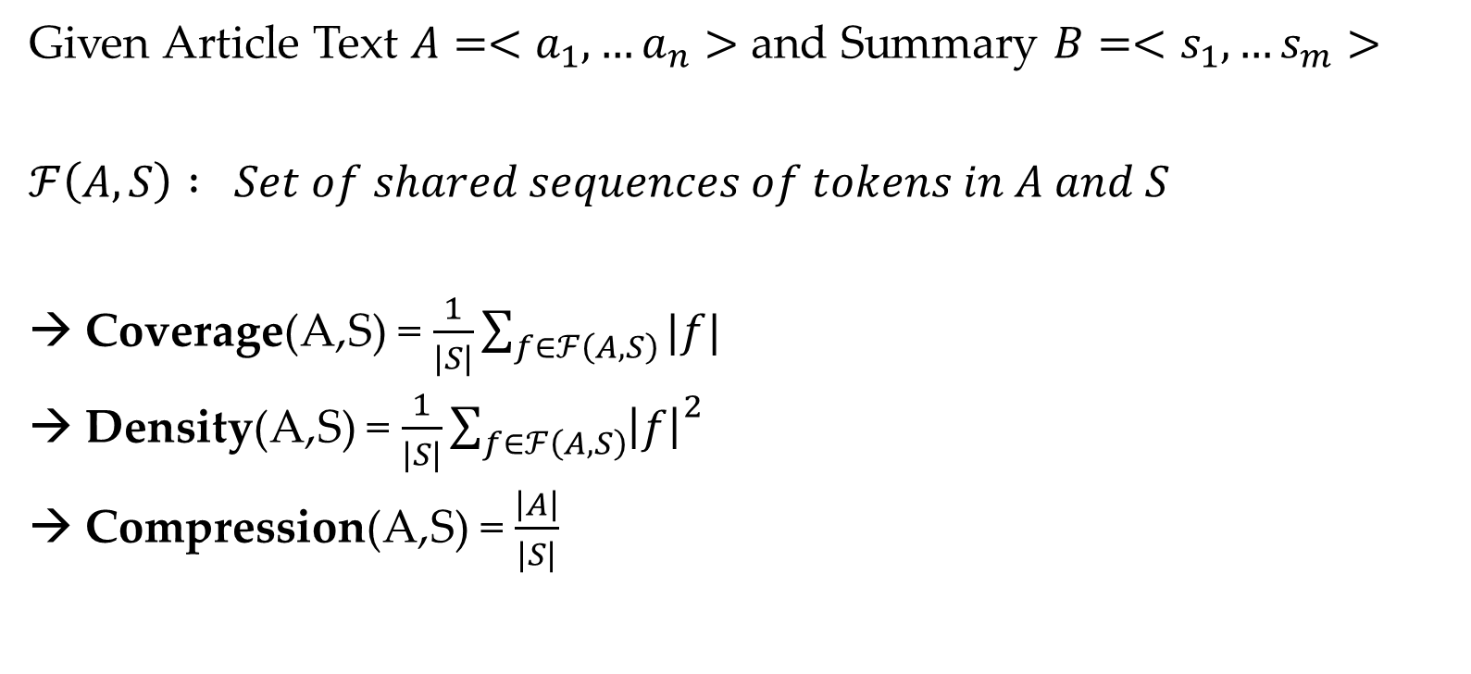

Capture the degree of text overlap between the summary and article
Given Article Text $A=<a_{1},…a_{n}>$ and Summary $B=<s_{1},…s_{m}>$
$ℱ\left(A, S\right) : Set of shared sequences of tokens in A and S$
→ Coverage(A,S) = $\frac{1}{|S|}\sum_{f∈ℱ\left(A, S\right)}{|f|}$
Density(A,S) = $\frac{1}{|S|}{\sum_{f∈ℱ\left(A, S\right)}{\left|f\right|}}^{2}$
Compression(A,S) = $\frac{\left|A\right|}{|S|}$
Article = Summary / Article $≠$ Summary
Coverage(A,S) = $\frac{3+4}{10}=0.7$
Density(A,S) = $\frac{3^{2}+4^{2}}{10}=2.5$
NEWSROOM: A Dataset of 1.3 Million Summaries with Diverse Extractive Strategies Max Grusky1,2 , Mor Naaman2 , Yoav Artzi1,2

Slide 3
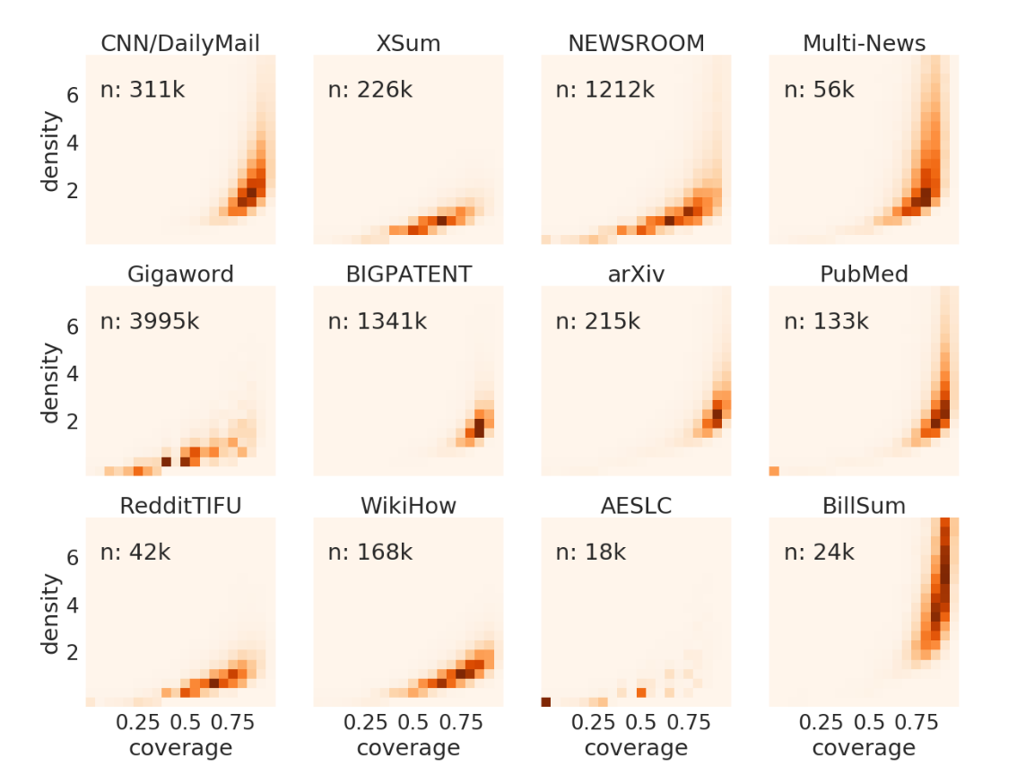
Summarization Data Compression
Something Extractive …
Density
Something Abstractive …
Coverage
PEGASUS: Pre-training with Extracted Gap-sentences for Abstractive Summarization

Slide 4
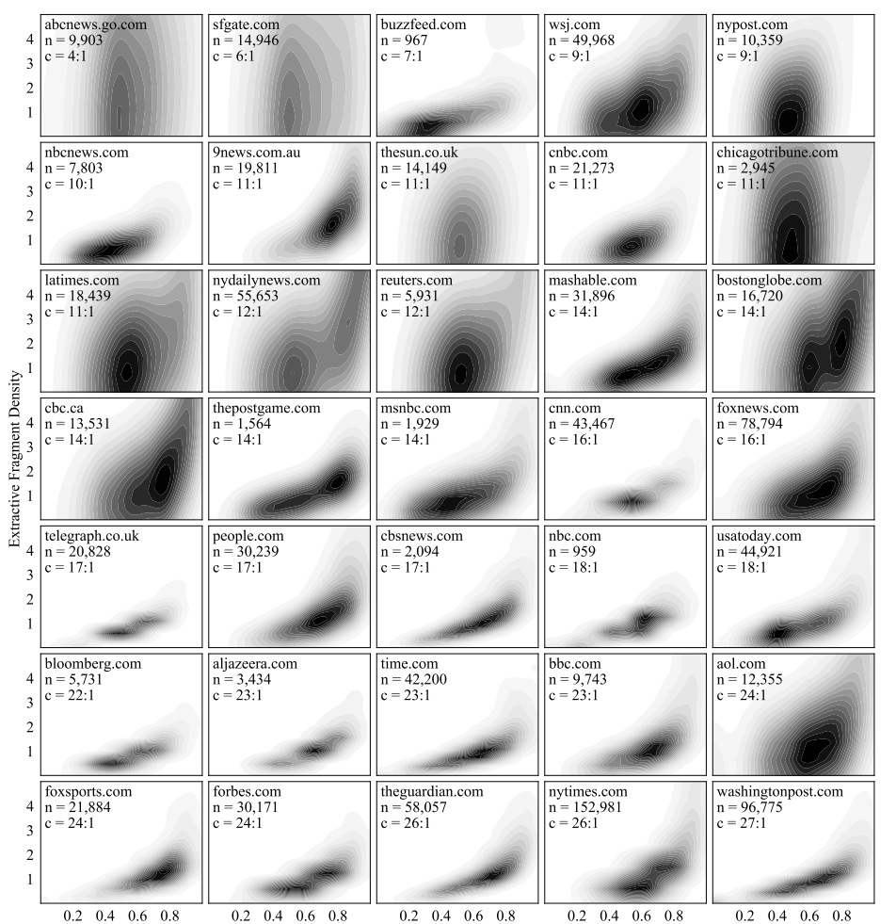
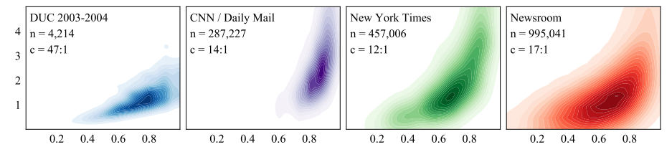
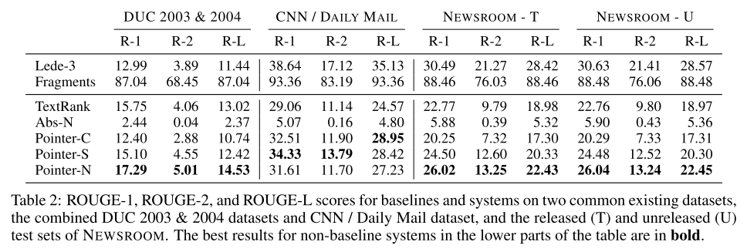
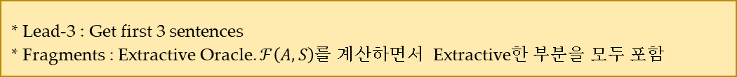
Construction of the NewRoom Dataset
* Lead-3 : Get first 3 sentences
* Fragments : Extractive Oracle. $ℱ\left(A, S\right)$를 계산하면서 Extractive한 부분을 모두 포함

